Slide 1




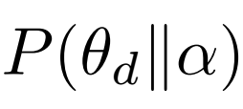
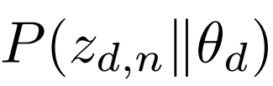
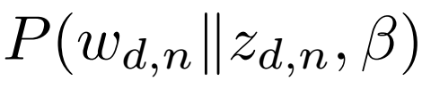




[Cluster of Words]
Lines as
Documents
Topic Modeling
K Topics
[Cluster of Documents]
Textbook
Dataset
K1
Kn
K2
W1..N → k1
W2…N → k2
LDA Model
Dirichlet
parameters
Document Topic
Distribution
Word-Topic
allocation
Observed
word
Topic-Word
distribution
Dirichlet
parameters
%alpha
φ
D documents
K Topics

